Slide 1
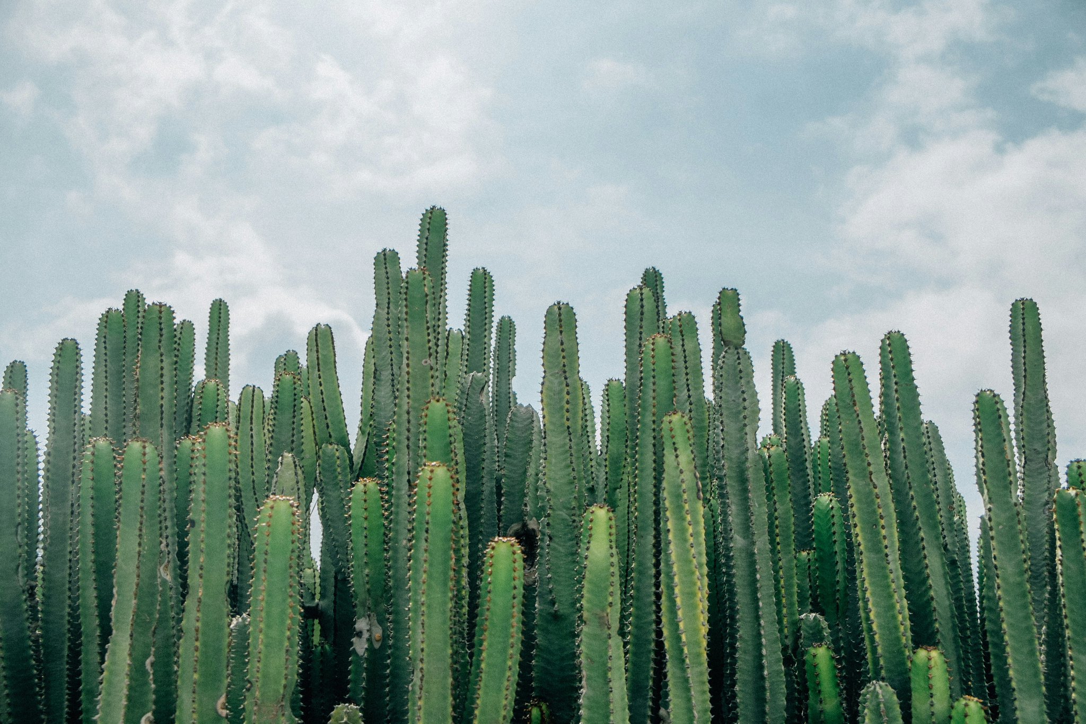
Aerial Cactus Detection
DTSA 5511
Photo by David Sola on Unsplash

Slide 2
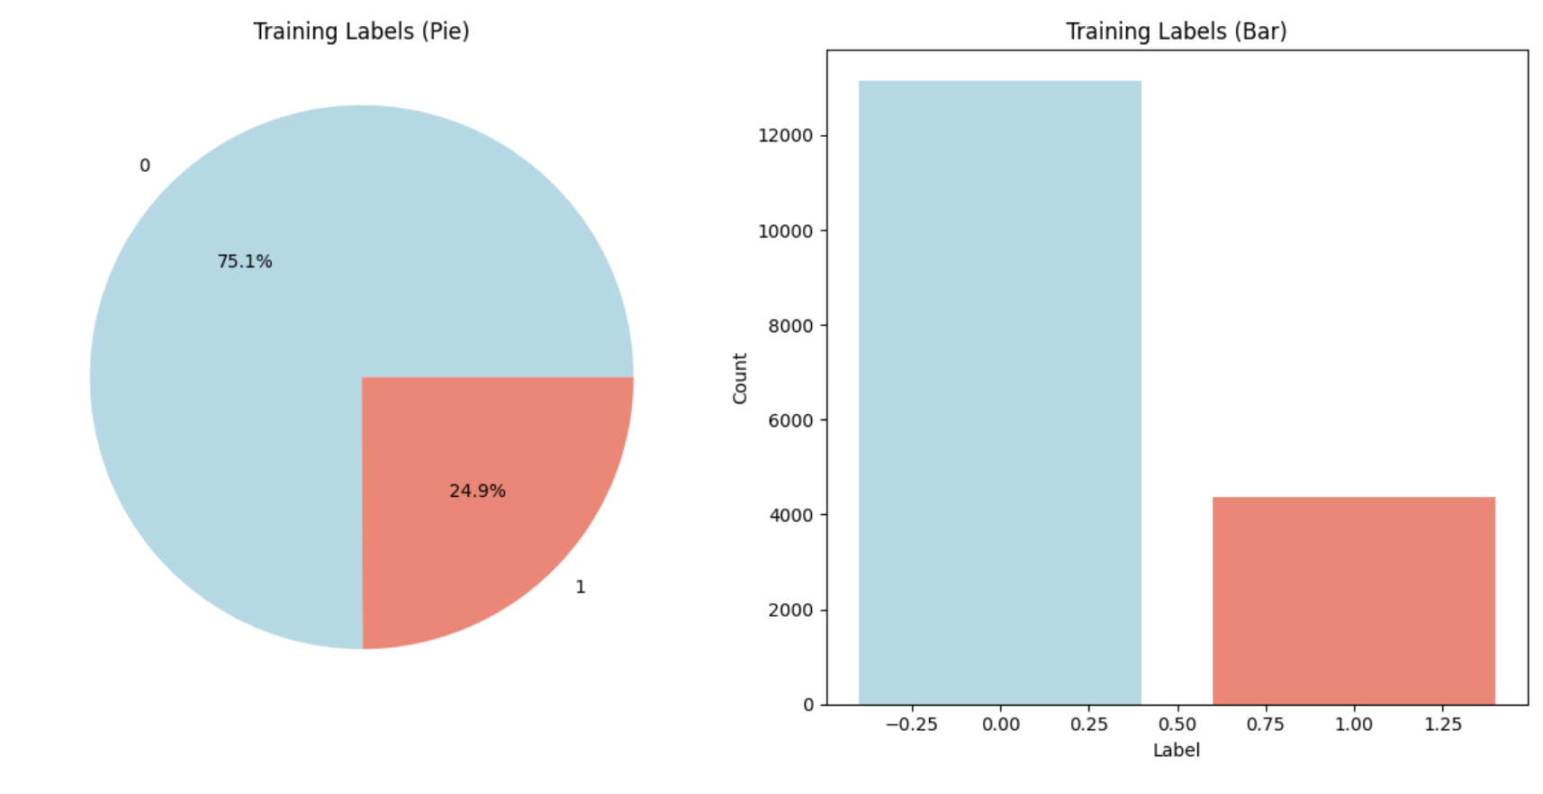
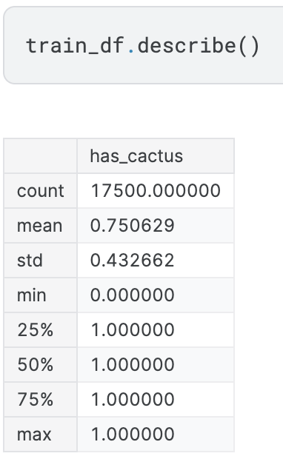
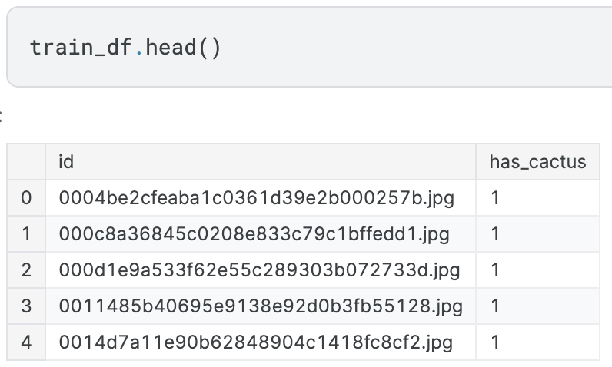
EDA

Slide 3
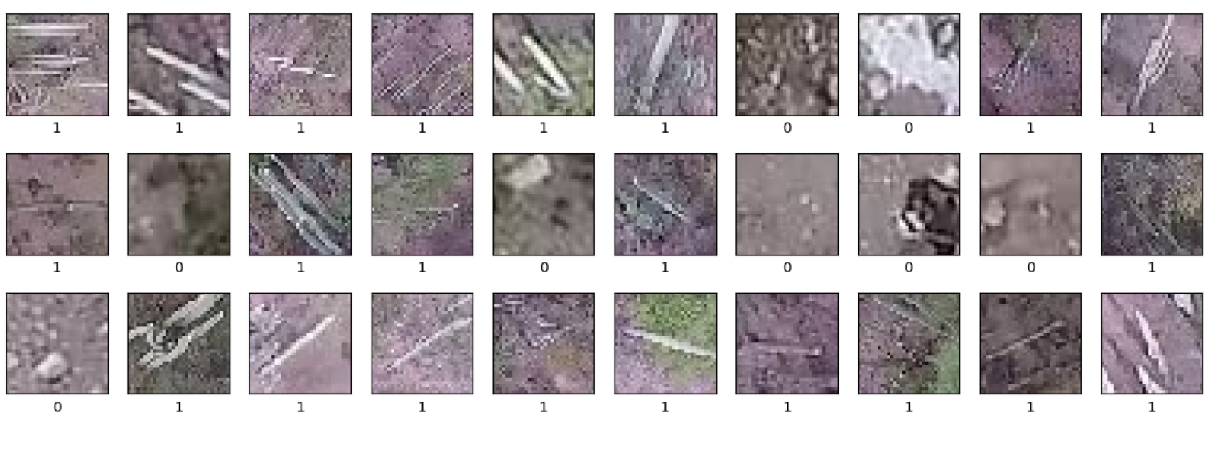
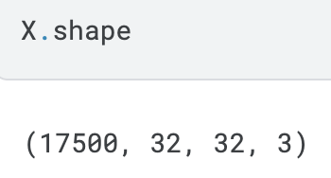
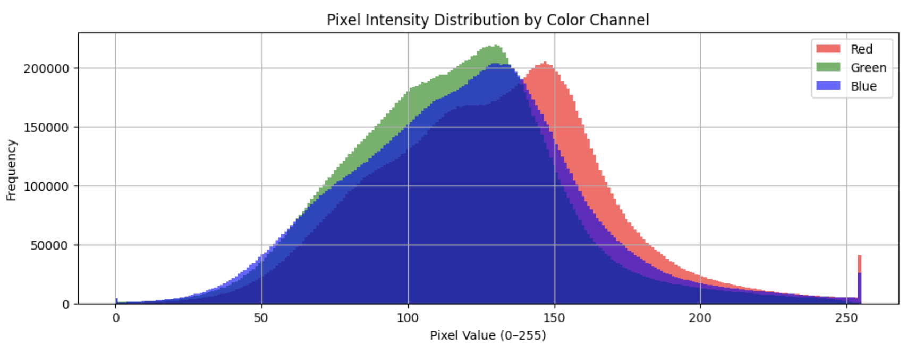
EDA

Slide 4
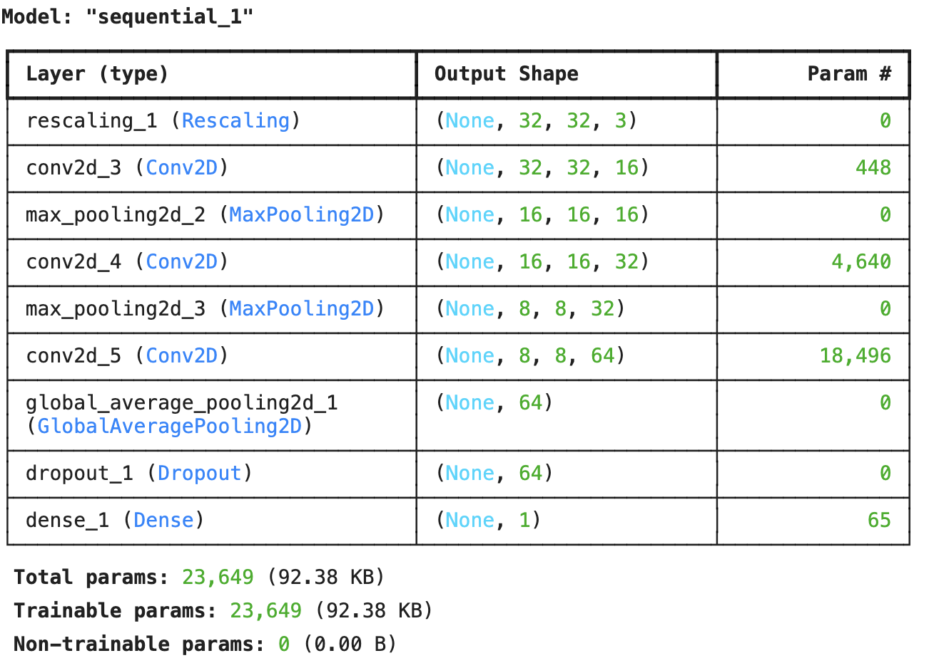
Modeling: Model 1

Slide 5
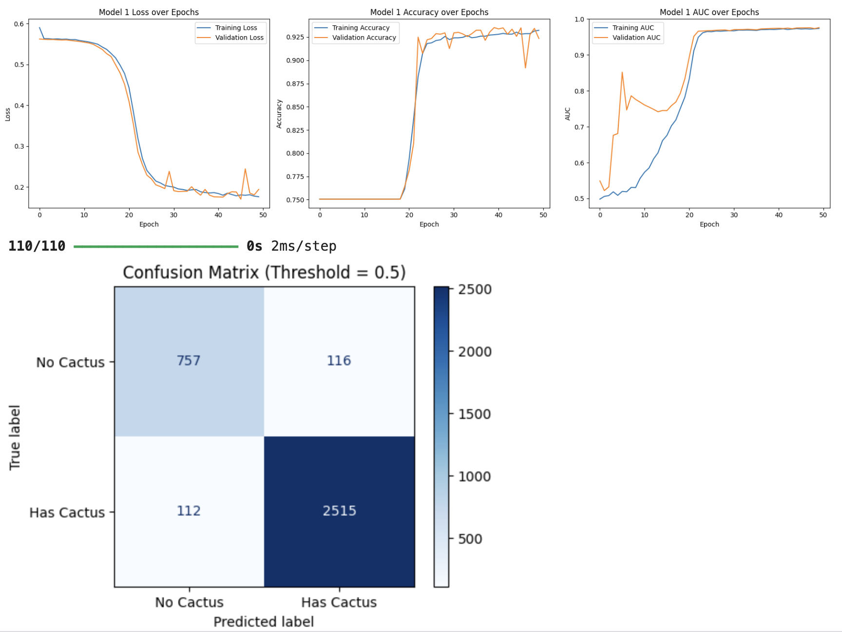
Analysis: Model 1

Slide 6
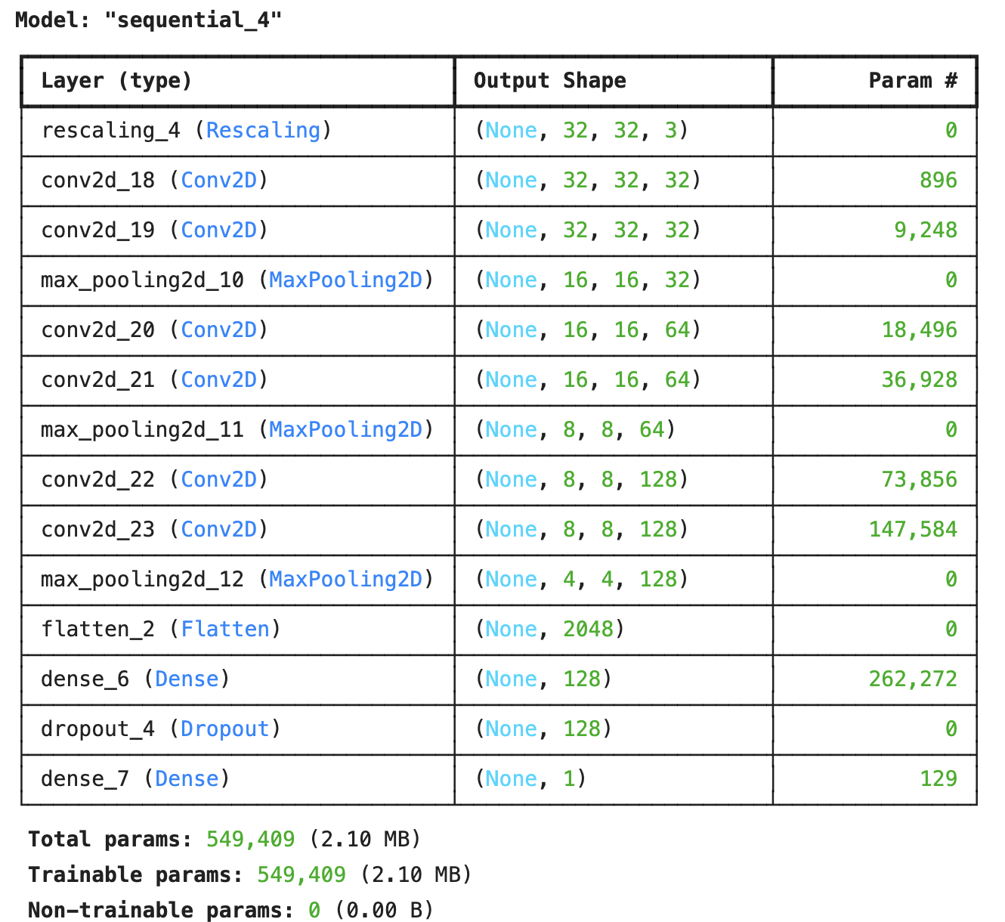
Modeling: Model 2

Slide 7
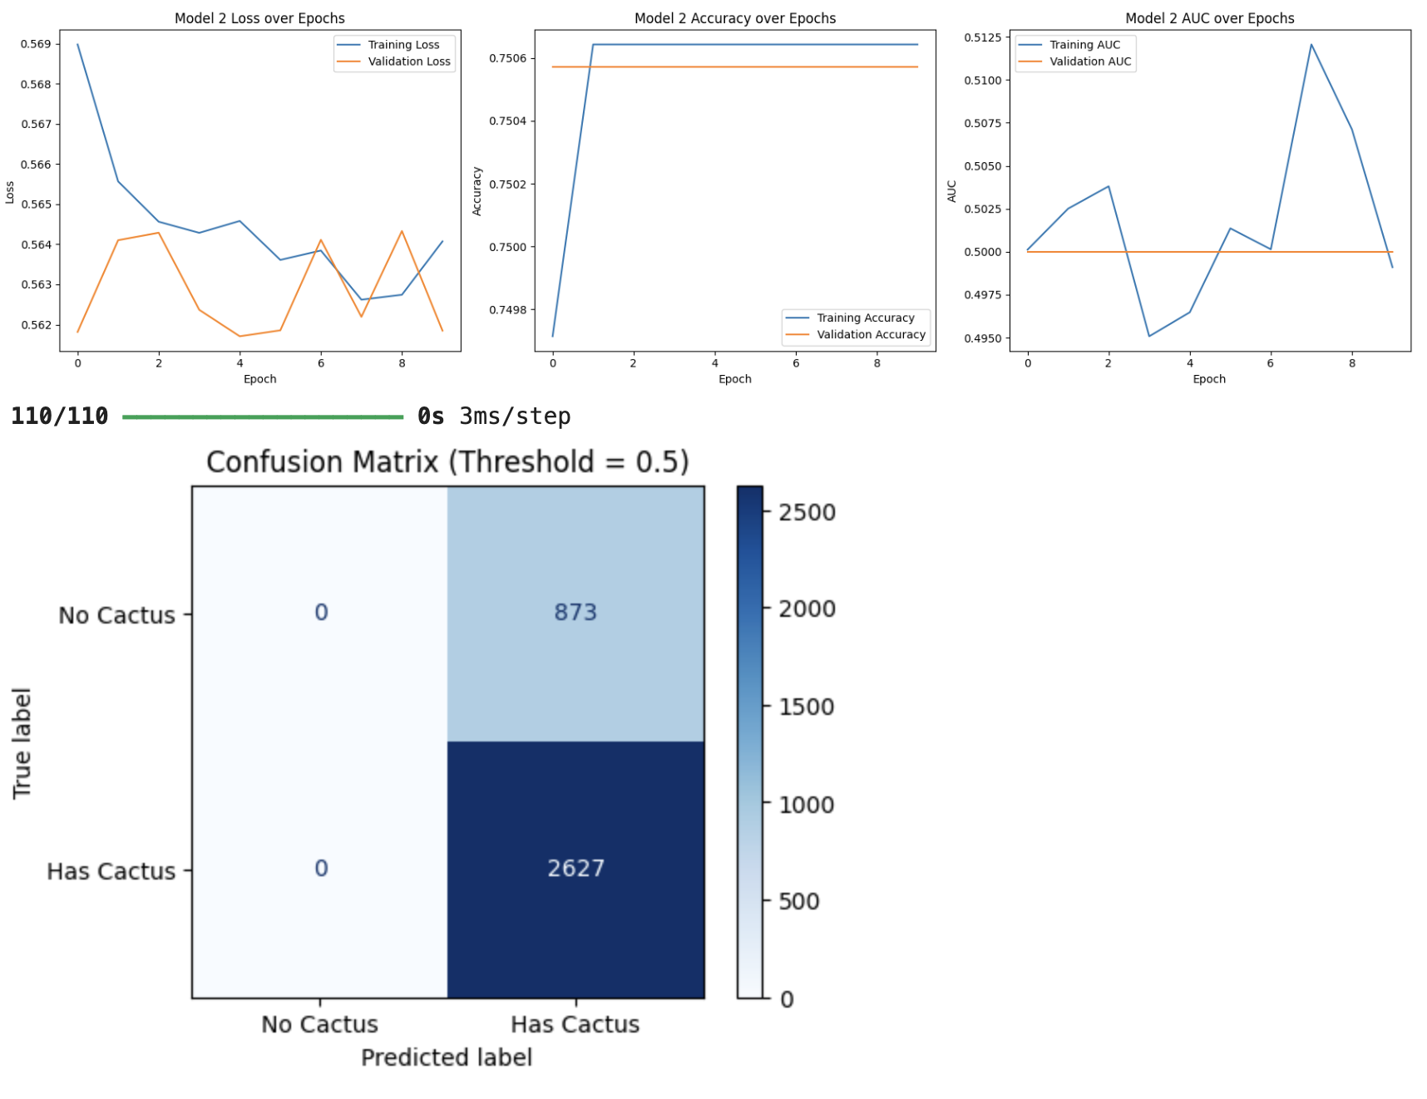
Analysis: Model 2

Slide 8
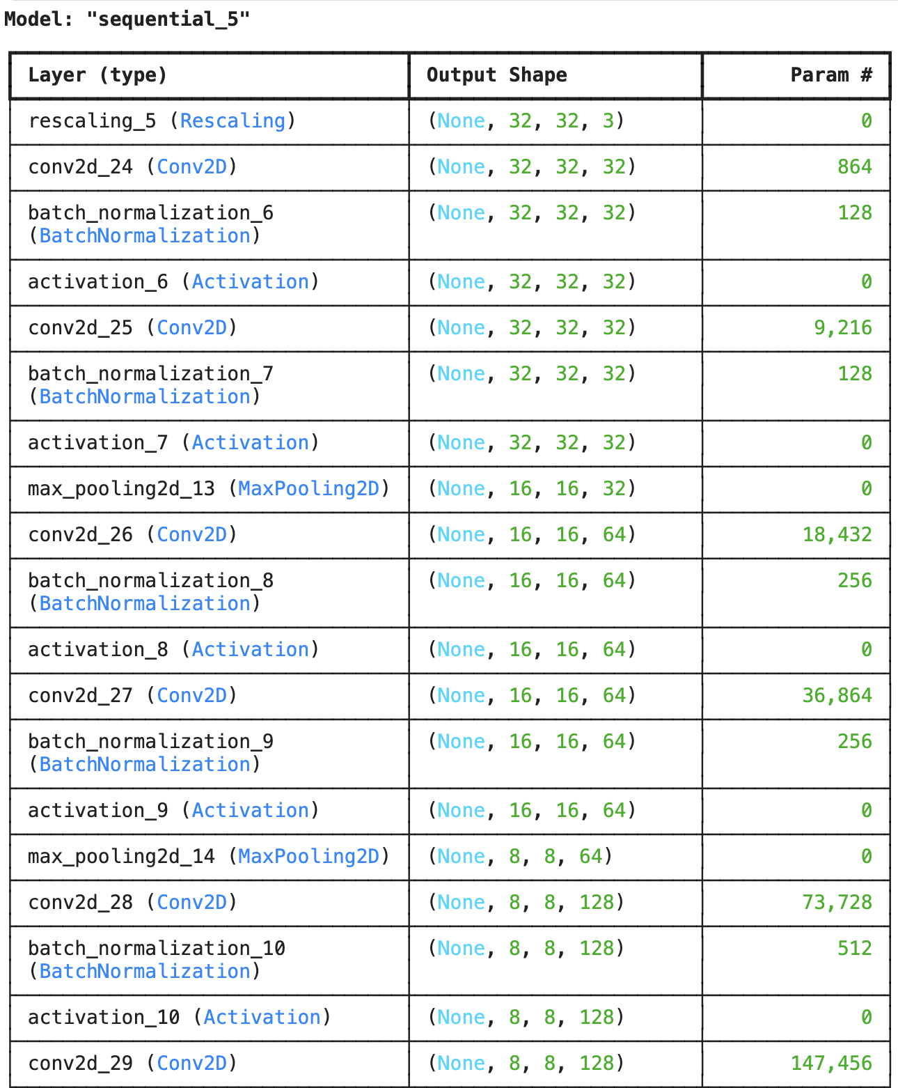
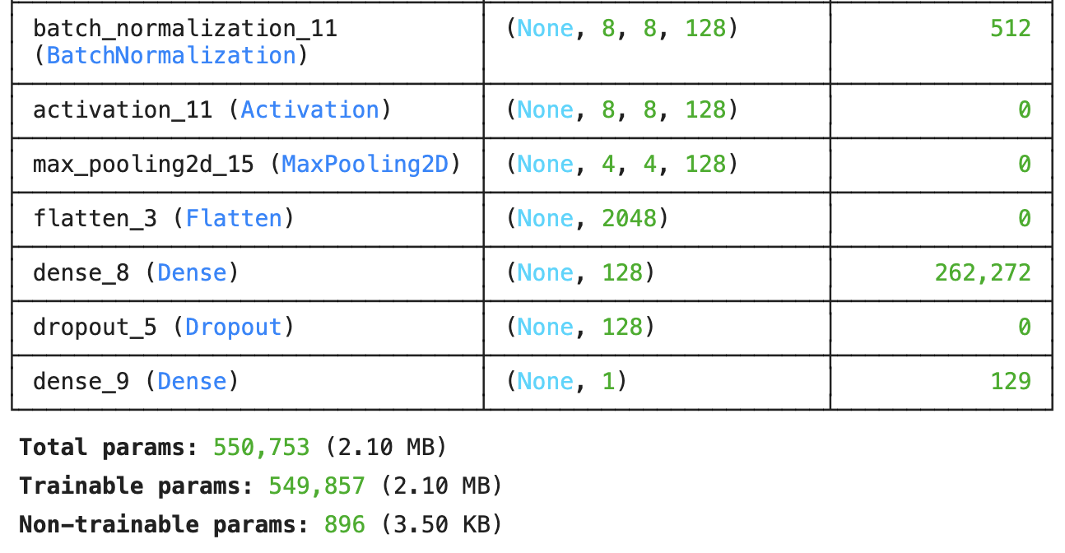
Modeling: Model 3

Slide 9
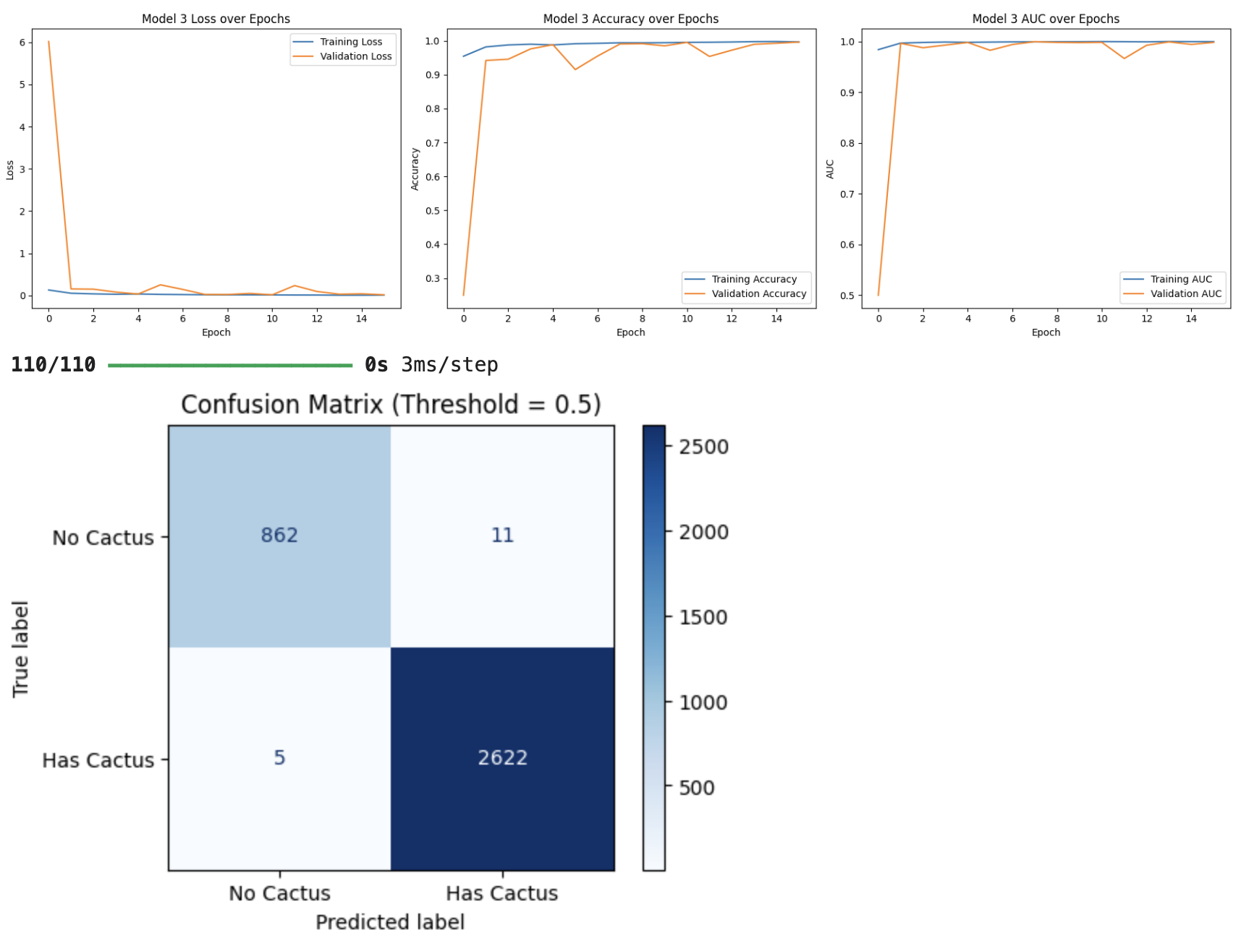
Analysis: Model 3

Slide 10
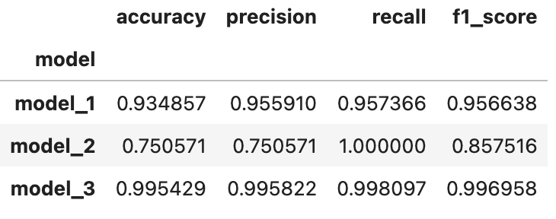
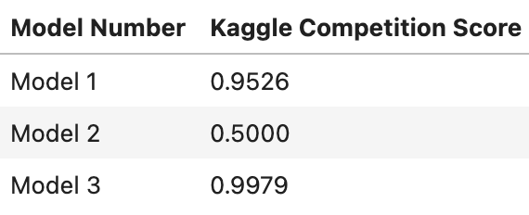
Analysis/Conclusion

Slide 11
References
https://www.tensorflow.org/io
https://keras.io/api/layers/pooling_layers/max_pooling2d/
https://keras.io/api/layers/pooling_layers/global_average_pooling2d/
https://keras.io/api/layers/convolution_layers/convolution2d/
https://keras.io/api/layers/normalization_layers/batch_normalization/
https://medium.com/@siddheshb008/vgg-net-architecture-explained-71179310050f
https://www.geeksforgeeks.org/machine-learning/imreadmulti-in-python-opencv/
https://www.kaggle.com/competitions/aerial-cactus-identification

Slide 12
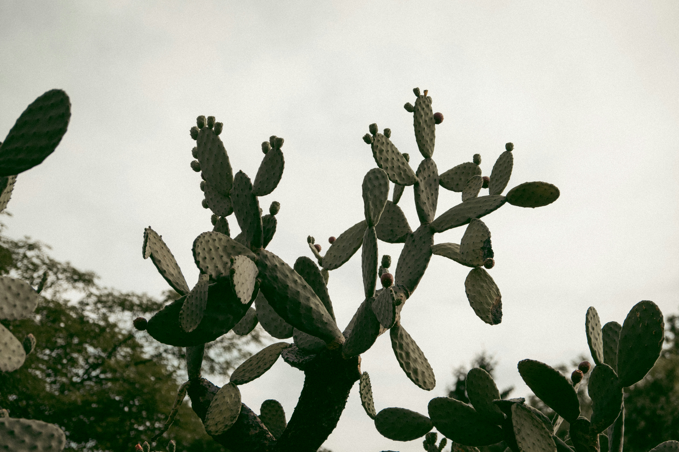
Thank you!
Photo by Nagy Arnold on Unsplash

